Slide 1


AIR ENGINE USING PNEUMATIC CYLINDER
Guided by
Mr.R.Manikandan
Presented by
1.RIYAZKHAN D (927622BME071)
2.ROHITH K (927622BME072)
3.MUTHUSELVAN M (927622BME314)

Slide 2
INTRODUCTION
One of the major problems most developing countries facing now a days is pollution
The major source of pollution is automobiles running on the roads.
Concerning resource availability there has been a strong warning that petroleum resources may be depleted in the relative near future.
There comes need to think about alternatives such as Biodiesel and Natural gas, electric cars, hybrid cars, hydrogen fuel cells but these alternative fuels also have some drawbacks.
One possible alternative fuel is the compressed air

Slide 3
CONSTRUCTION
The base frame for mounting overall arrangement is fabricated with the help of square tubes and channels with welding.
The pneumatic cylinder is mounted on the base frame whose end of the piston rod is coupled to the crank shaft which is coupled to the base frame with the help of bearing at its end for attaining free rotation.
The pneumatic cylinder is connected to the solenoid valve with the help of hoses for controlling it timer circuit is paired with it.

Slide 4
WORKING PRINCIPLE
When the timer circuit get turned on it functions the pneumatic cylinder to extend and retract based upon the programmed time control.
The solenoid valve allows the compressed air from the compressor to the pneumatic cylinder to extend it.
This linear activation obtained is converted into half the rotation of crank shaft and its next half rotation is obtained by retraction of pneumatic cylinder.
Due to its continuous activation a rotational movement is obtained which is stabilized with the help of flywheel arrangement and it is utilised for commercial applications.

Slide 5
MAJOR COMPONENTS MAJOR COMPONENTS
PNEUMATIC CYLINDETR
LIMIT SWITCH
SOLENOID VALVE
HOSE AND CONNECTOR
FRAME
SHAFT
BEARING
METAL STRIP
FLY WHEEL
CRANK SHAFT
COMPRESSOR

Slide 6
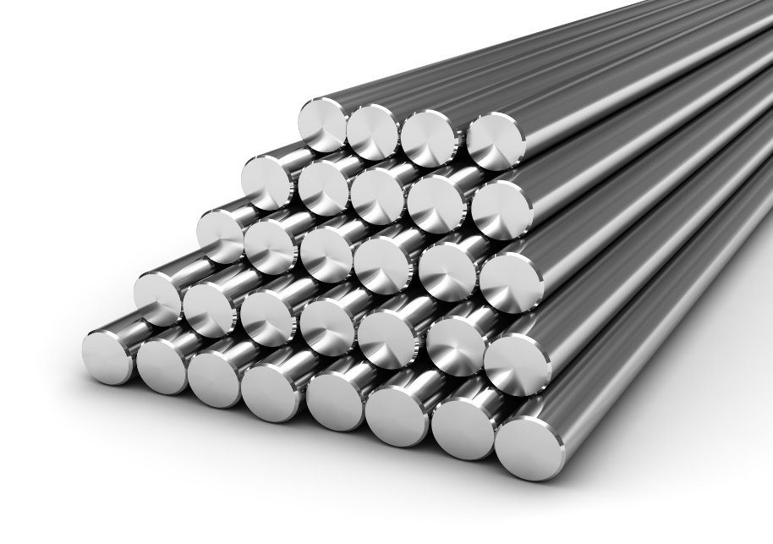
SHAFT
Shaft is used to connect the pneumatic cylinder and the wheel

Slide 7
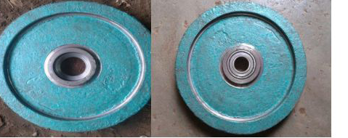
FLYWHEEL
Fly wheel is used to achieve the rotatory motion by the crank movement of the pneumatic cylinder

Slide 8
DOUBLE ACTING PNEUMATIC CYLINDER
A double-acting pneumatic cylinder is a type of pneumatic cylinder that uses compressed air to generate mechanical motion.
Pneumatic cylinders are commonly used in various industrial applications for tasks such as pushing, pulling, lifting, and holding objects. The "double-acting" designation refers to the fact that the cylinder can perform work in both directions – extending and retracting.

Slide 9
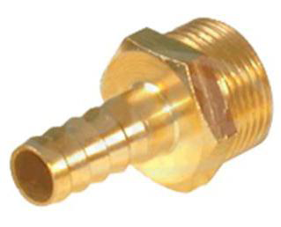
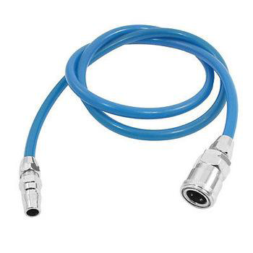
HOSE AND CONNECTER
A hose coupling is a connector on the end of a hose to connect (or couple) it with another hose or with a tap or a hose appliance, such as an irrigation sprinkler. It is usually made of steel, brass, stainlesteel, aluminium or plastic

Slide 10
AIR COMPRESSOR
An air compressor is installed along with the body
Air compressor is used to provide air to the pneumatic cylinder for the forward and backward movement

Slide 11
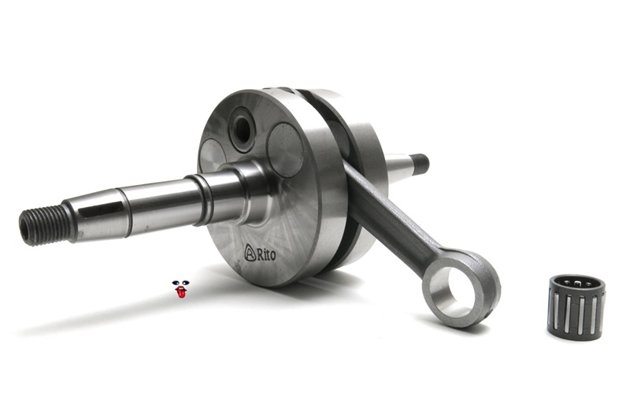
CRANK SHAFT
A crankshaft—related to crank—is a mechanical part able to perform a conversion between reciprocating motion and rotational motion In a reciprocating engine, it translates reciprocating motion of the piston into rotational motion; whereas in a reciprocating compressor, it converts the rotational motion into reciprocating motion

Slide 12
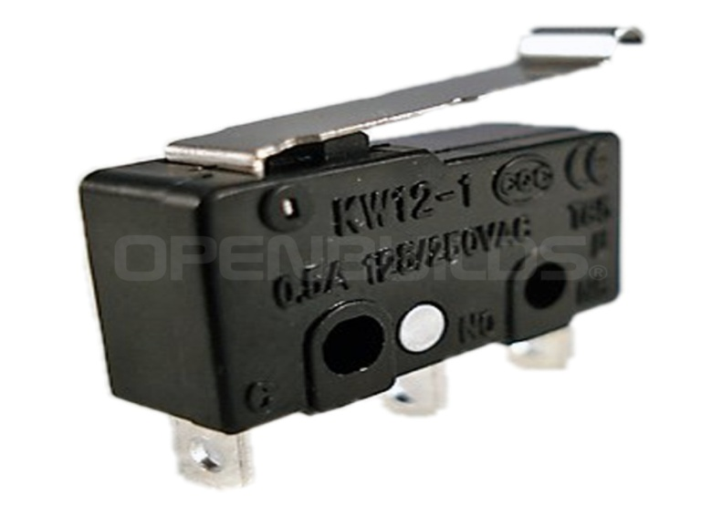
LIMIT SWITCH
electrical engineering a limit switch is a switch operated by the motion of a machine part or presence of an object.

Slide 13
ADVANTAGES
The temperature of the engine while working will be slightly less than the ambient temperature.
Smooth working of the engine due to very less wear and tear of the components.
There is no possibility of knocking.
No need of cooling systems and spark plugs or complex fuel injection systems.
The engine runs on cold or warm air, Compressors use electricity for generating compressed air which is relatively much cheaper and widespread.
Compressed-air technology reduces the cost of vehicle production by about 20%, because there is no need to build a cooling system, fuel tank, Ignition Systems or silencers.
Low manufacture and maintenance costs as well as easy maintenance.
Lighter vehicles cause less damage to roads, resulting in lower maintenance cost.

Slide 14
APPLICATION
This system can be applicable for automobiles, machineries and for commercial equipment.

Slide 15
ENERGY CONSUMPTION OF E-VEHICLES
ENERGY CONSUMPTION OF E-VEHICLES
There are different types of compressor if we use a compressor with high rated kW there will be more efficiency than E vehicles
Formula for energy consumption
Energy consumption (kWh)=power(kW)*time(hours)
For example if we use 5kW rated compressor and run it for 1 hour
Energy consumption (kWh)=5(kW)*1hour=5kWh
In this scenario if we would need 5 kWh to run the air compressor

Slide 16
MATERIAL USED
S.No | DESCIRPTION | QTY | MATERIAL
1. | PNEUMATIC CYLINDER | 1 | ALUMINIUM
2. | SOLENOID VALVE | 1 | PLASTIC
3.. | BEARING | 4 | STAINLESS STEEL
4. | FRAME | AS PER REQUIRMENT | MILD STEEL
5.. | SHAFT | AS PER REQUIRMENT | MILD STEEL
6. | METAL STRIP | AS PER REQUIRMENT | MILD STEEL
7. | FLY WHEEL | 1 | MILD STEEL
8. | HOSE AND CONNECTOR | 2 METRE AND 5 | PLASTIC AND STAINLESS STEEL
9. | CRANK SHAFT | 1 | STAINLESS STEEL
10. | LIMIT SWITCH | 1 | ELECTRICAL
11. | COMPRESSOR | 1 | MILD STEEL
12
13.

Slide 17
POWER USAGE
ENERGY SUPPLY NEED TO RUN E-VEHICLE FOR 1 HOUR | ENERGY SUPPLY NEED TO RUN COMPRESSOR FOR 1 HOUR
It would approximately take 15-30 kwh | It would approximately take 5-10 kwh based on the compressor
It takes more power than the compressor | It takes less power than the E-vehicles

Slide 18
COST ESTIMATION
S.No | DESCIRPTION | RATE
1. | PNEUMATIC CYLINDER | 1000
2. | SOLENOID VALVE | 800
3.. | BEARING | 400
4. | FRAME | 1000
5.. | SHAFT | 200
6. | METAL STRIP | 200
7. | FLY WHEEL | 1500
8. | HOSE AND CONNECTOR | 400
9. | CRANK SHAFT | 800
10. | LIMIT SWITCH | 200
11. | COMPRESSOR
12 | TOTAL | 6500
13.

Slide 19
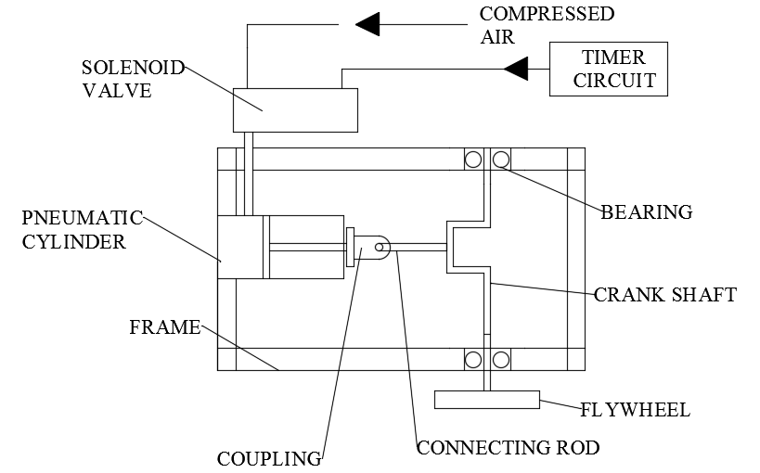
BLOCK DIAGRAM

Slide 20


